Slide 1
Tracking Progress in Transportation Sustainability: Nova Scotia Travel Activity (NovaTRAC) survey
Dr. Ahsan Habib, Associate Professor
School of Planning, and Department of Civil and Resource Engineering, Dalhousie University
Session: Best Practices in Urban Transportation Planning
Transportation Association of Canada Conference
September 24-27
St. John’s, NL

Slide 2
Research Links
Transportation
Health
Environment

Slide 3
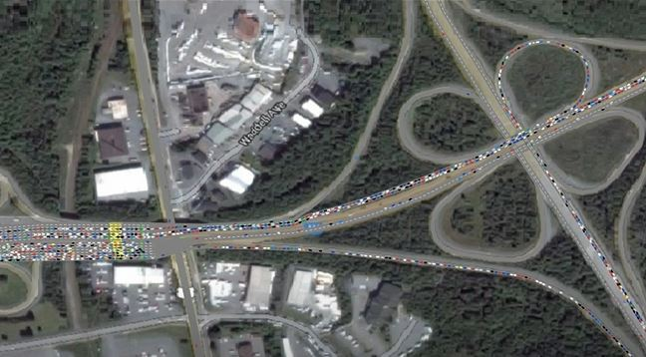
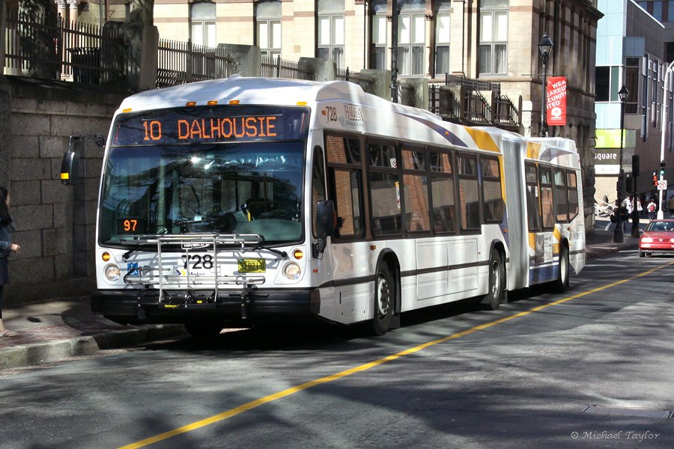
Travel Surveys
Travel surveys are critical for cities to:
develop transport network models
provide information for evidence-based decision making
monitor transportation system performance
track progress in sustainable travel behaviour
Notes:
Bus Image: https://www.halifaxexaminer.ca/wp-content/uploads/2016/04/route10MichaelTaylor.jpg

Slide 4
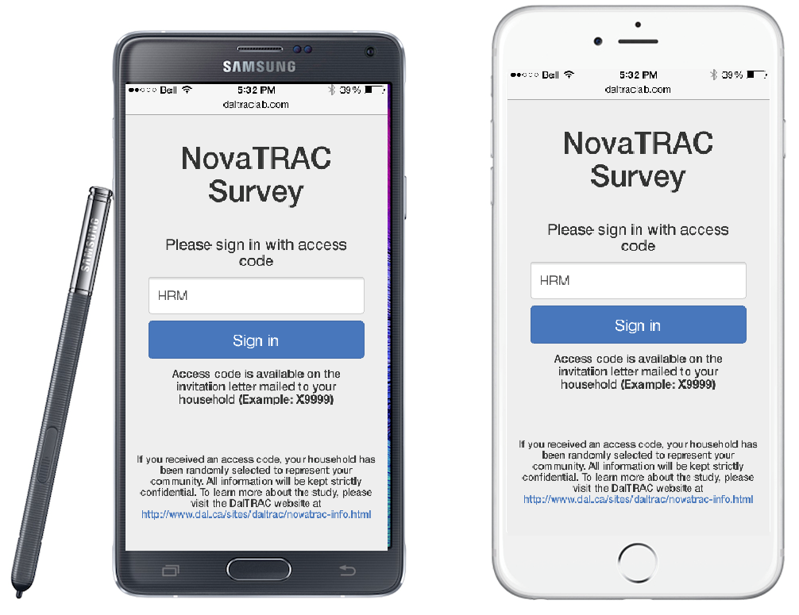
NovaTRAC survey
About your household
Number and types of vehicles
Number of people living in household
Ownership status and type of house
About each person living in your home
Age
Education and Employment
Transit pass ownership
24-Hour Travel Log
Location of Place A and Place B
Reason for making the trip
Start time of the trip
Mode of transportation used

Slide 5
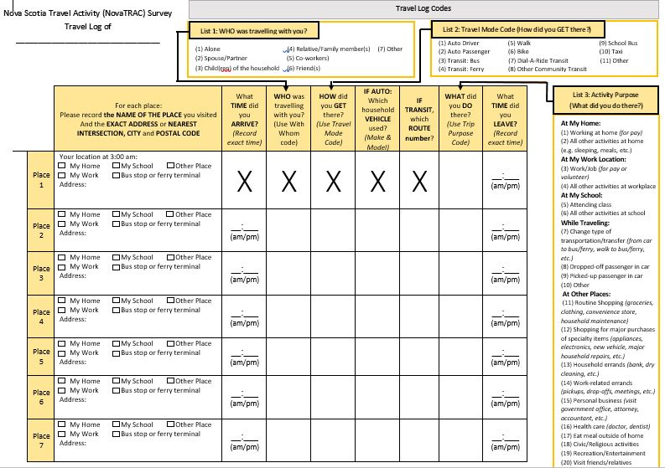
NovaTRAC survey

Slide 6
Emission Modeling
Fuel Consumption for Passenger Transport per Capita and Total Amount
2015
2016
1203 L per capita
1109.25 millions of L
1204 L per capita
1198.34 millions of L
1 L
per capita

Slide 7
Emission Modeling
GHG Emissions for Passenger Transport per Capita and Total Amount
2015
2016
2.987 tonnes per capita
2.75 millions tonnes
GHG
3.012 tonnes per capita
2.99 millions tonnes
0.025 tonnes
per capita

Slide 8
Health Indicators
1. Health Status
2. Happiness
3. Typical Weekdays
4. Physical Activity

Slide 9
Age

Slide 10
Income

Slide 11
Employment Level

Slide 12
Gender

Slide 13
Household Size

Slide 14
Attitudinal Insights
Statements | Percentage of Respondents
 | Strongly Agree | Agree | Neutral | Disagree | Strongly Disagree
I enjoy riding a bicycle | 32.2% | 29.8% | 19.9% | 9.3% | 8.8%
I prefer walking to driving whenever possible | 30.5% | 33.1% | 19.0% | 13.4% | 4.0%
I feel happier when riding a bike | 9.6% | 14.8% | 27.8% | 24.5% | 23.3%
I take pride in owning a car | 15.3% | 32.5% | 31.8% | 10.8% | 9.6%
Driving provides me with freedom | 41.0% | 41.8% | 10.9% | 4.7% | 1.6%
I am fully satisfied with my commute | 24.0% | 33.7% | 20.9% | 16.4% | 4.8%
My commute makes me feel stressed | 5.6% | 14.1% | 22.7% | 34.4% | 23.3%
I am happy with where I live | 47.1% | 38.1% | 8.3% | 5.2% | 1.4%
I invest a lot of time into the community I live in | 15.1% | 29.2% | 32.4% | 18.9% | 4.5%
A suburban environment offers the best quality of life | 6.8% | 23.1% | 29.7% | 23.0% | 17.4%
I limit my driving because it is bad for air quality | 8.8% | 21.2% | 30.3% | 32.2% | 7.5%
I consider global warming a major concern | 44.0% | 38.0% | 14.4% | 2.6% | 1.1%

Slide 15
Moving Forward

Slide 16
Thank You
Acknowledgements
Funding Agencies: MEOPAR, NSERC-DG, CFI
DalTRAC Contributors: Nazmul Arefin Khan and Sara Campbell

