Slide 1
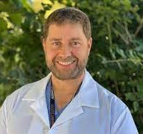
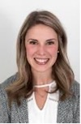
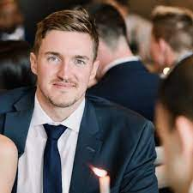
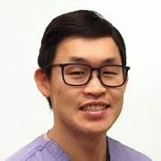
Dr. Darling has named Dr. Sean Christie the Deputy Chair and Interim Director of the Department of Surgery Research Committee. Dr. Christie is a Professor of Surgery in the Division of Neurosurgery. His research in the basic sciences embodies secondary injury mechanisms and seeks to uncover potential “translate-able” therapies for spinal cord injury. He is also a leading clinician researcher looking and examining the impact of global warming and its correlation to clinical practice. https://www.thecoast.ca/news-opinion/greening-nova-scotias-healthcare-system-in-a-covid-19-world-25323481 Dr. Christie knows the “lay of the land” of the research community here at Dal Surgery, and will help guide and lead the Research Committee to investing our research dollars for: new faculty support, operational grant monies and continuing to build on Dr. Dunbar’s vision by working towards an internal data team/support hub. Ideally creating a research centre accessible to all faculty and residents to utilize and foster a wider more impactful research- generated Department of academic surgery.
Department of Surgery RESEARCH
Bulletin – June 2023
2023-2024
Department of Surgery Research Committee
Dr. Michael Dunbar
Chair
Dr. Sean Christie
Deputy Chair
Committee Members:
Dr. Katerina Neumann
Dr. Richard Spence
Dr. Alison Wallace
Dr. Jim Fawcett
Dr. Thomas Issekutz
Dr. Emily Krauss
Dr. Christine Herman
Dr. Paul Hong
Dr. Robin Urquhart
Dr. Mark Glazebrook
Dalhousie Faculty of Medicine Resident Research Awards
Dr. Anna Duncan - Best Overall Presentation
“The effect of silver on re-epithelialization, infection, and hypertrophic scarring of partial thickness burns in pediatric patients: A randomized control trial”
Dr. Mark MacLean – Best Work Basic Science Research
“NMDA-Receptor Antagonism for the Prevention of Neurological Dysfunction in Traumatic Brain Injury: Results of a Randomized Pre-Clinical Trial”
Research Day 2024
Halifax Convention Centre
Wednesday April 10, 2024
Congratulations to Dr. Jae Ho Han, CIP Neurosurgery Resident on his recent successful defence of his Master’s in Medical Sciences thesis “Extracellular vesicles (EVs) in patient plasma can predict Glioblastoma multiforme (GBM) recurrence; EV concentration increases during surgery for GBM”
During his CIP protected time, Dr. Jae Ho Han was a trainee in the Cancer Research Training Program of the Beatrice Hunter Cancer Research Institute, with funds provided by the Terry Fox Research Institute’s Marathon of Hope Atlantic Cancer Consortium”.
Congrats Dr. Han Ho!

